Slide 1
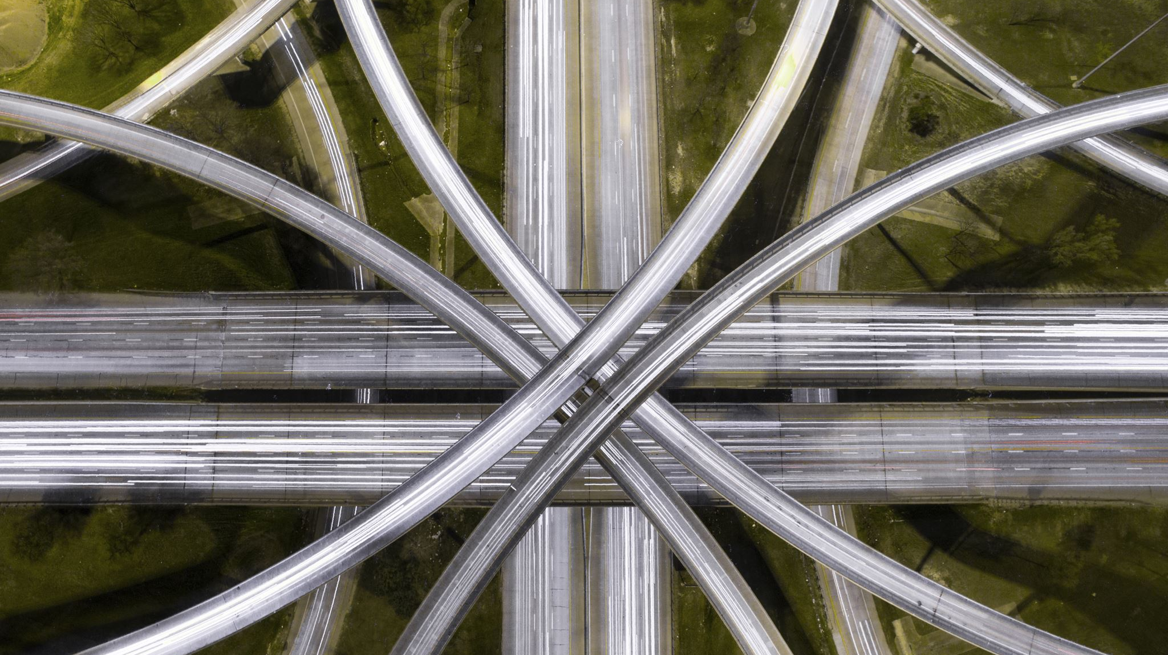
Autonomous Intersection Management (AIM)
By: Charles Arsenal Okere Muhammad Amirul Hakimi bin Zaprunnizam(Amirul) Muhammad Iqbal bin Mohd Fauzi(Iqbal) Muhammad Farid Izwan bin Mohamad Shabri(Farid)

Slide 2
Problem?
Car crashes at intersection point or junction without traffic controls.
Time wasted
Emission

Slide 3
Solution
V2V Protocol = Share datas between one vehicle to another for example speeds,
Total Bandwidth Server Algorithm = Scheduling aperiodic task
Vehicle Collision Warning Communication Protocol
Management Centre/Server Hub to send information
Fcfs

Slide 4
Design
Use Case Diagram
Activity Diagram

Slide 5
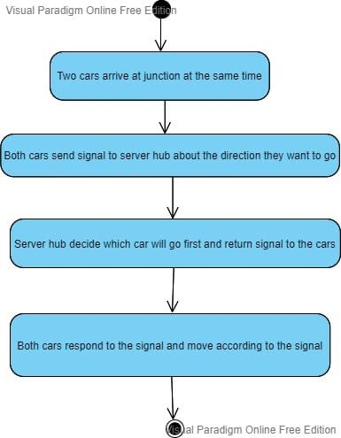
Activity Diagram

Slide 6
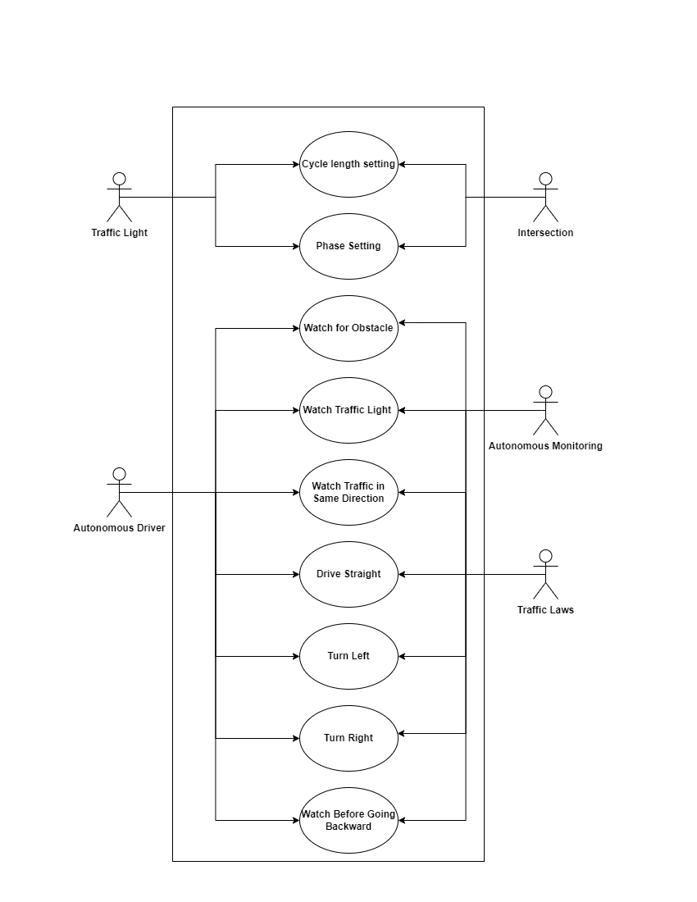
Use Case Diagram

Slide 7
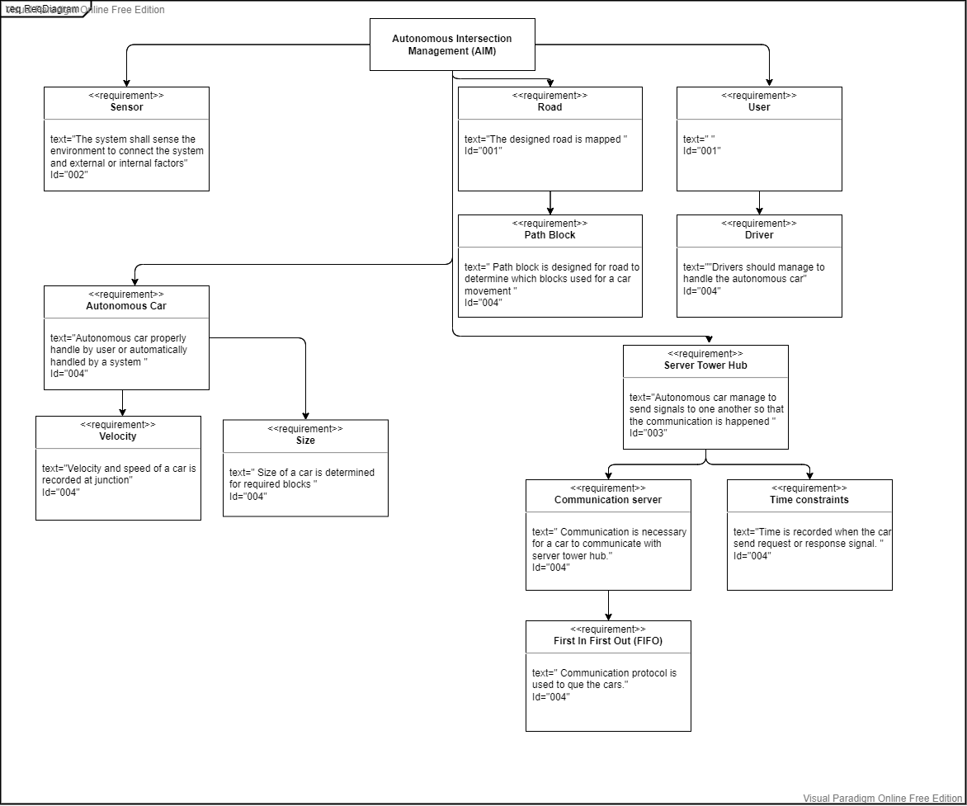
Requirement Diagram

Slide 8
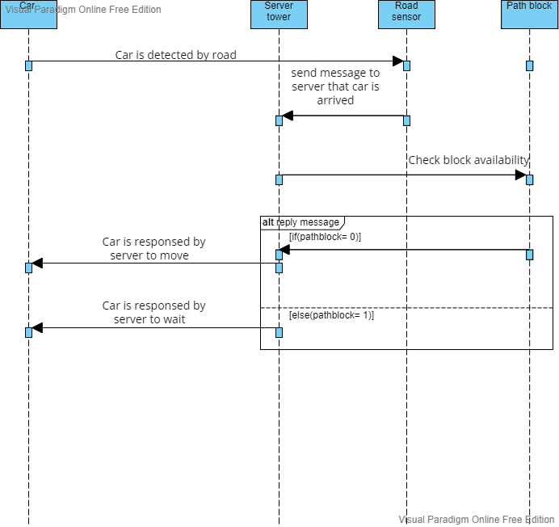
Sequence Diagram

